Slide 1
Joins in RDBMS

Slide 2
Agenda
Concept
2. Inner join
Outer join
Multiple joins
Summary

Slide 3
1. Concept
Handling data from multiple files
Types of join
Cross join
Inner join
Outer join
Joins on multiple tables
Summary

Slide 4
. 2. Cross Join
Syntax
select *
from table1
join table2;
Will generate cartesian product.

Slide 5
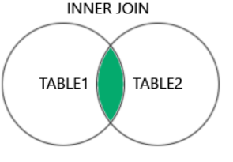
Inner join
ename | deptno
smith | 20
Miller | 30
jones | 10
deptno | dname
20 | Sales
40 | Mkt
ename | deptno | dname
smith | 20 | sales
output
dept
emp

Slide 6
. 3. Inner Join
Types
1. Equi join
2. Non equi join
3. Self join
Syntax- Equi join
select *
from table1
join table2
on table1.column = table2.column;
Will fetch common data from both the tables.
Syntax- Non equi join
select *
from table1
join table2
on table1.column between table1.column and table2.column;
Will fetch common data
Syntax- Self join
select *
from table1
join table2
on table1.column1 = table1.column2;

Slide 7
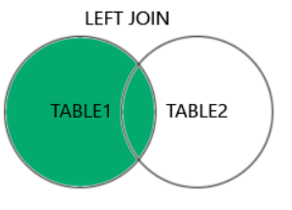
Outer join
Left outer join
ename | deptno
smith | 20
Miller | 30
jones | 10
deptno | dname
20 | Sales
40 | Mkt
ename | deptno | dname
smith | 20 | sales
Miller | 30 | null
jones | 10 | null
dept
output
emp

Slide 8
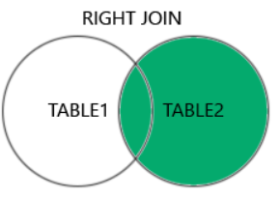
Outer join
Right outer join
ename | deptno
smith | 20
Miller | 30
jones | 10
deptno | dname
20 | Sales
40 | Mkt
50 | R&D
ename | deptno | dname
smith | 20 | sales
null | 40 | Mkt
null | 50 | R&D
dept
output
emp

Slide 9
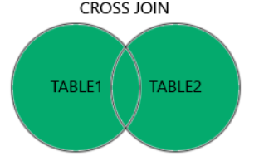
Outer join
Full join
ename | deptno
smith | 20
Miller | 30
jones | 10
deptno | dname
20 | Sales
40 | Mkt
50 | R&D
ename | deptno | dname
smith | 20 | sales
Miller | 30 | null
jones | 10 | null
null | 40 | Mkt
null | 50 | R&D
dept
emp
output

Slide 10
. 4. Outer Join
Types
1. Left outer join
2. Right outer join
3. Full join
Syntax- Left outer join
select *
from table1
left join table2
on table1.column = table2.column;
Will fetch common data + all the data from left table.
Syntax- Right outer join
select *
from table1
right join table2
on table1.column = table2.column;
Will fetch common data + all the data from right table.
Syntax- Full outer join
select *
from table1
left join table2
on table1.column = table2.column
union
select *
from table1
right join table2
on table1.column = table2.column;

Slide 11
. 5. Multiple Joins
Syntax- Multiple join
select *
from table1
join table2
on table1.column = table2.column
join table3
on table1.column = table3.column;
e.g
select *
from emp e
join dept d
on e.deptno = d.deptno
join salgrade s
on e.sal between s.losal and s.hisal;

Slide 12
Summery
Concept
2. Inner join
Outer join
Multiple joins

